Slide 1

Unified Explainable Artificial Intelligence
for Business Analytics
Comparing ML Models and XAI Techniques
REVIEW – 3 | BATCH – 2
2420030525
2420030508
2420030529

Slide 2
1. Problem Statement
Machine learning models are increasingly used in educational and business analytics for prediction and decision-making, but complex models are often difficult to interpret. Different models and explainable AI techniques may provide varying levels of accuracy and transparency. Therefore, this project aims to comparatively analyze multiple machine learning models using SHAP and LIME to evaluate their predictive performance and explainability across benchmark datasets.
2

Slide 3
2. Objectives
To develop machine learning models for analyzing and predicting outcomes from benchmark business datasets.
To integrate SHAP and LIME techniques to provide clear and meaningful explanations of model predictions.
To enhance model transparency and interpretability for better understanding of business-related predictions.
To evaluate and compare model performance and explainability to identify the most effective approach.
3

Slide 4
3. Dataset & Analytics Pipeline
• UCI Bank Marketing Dataset (UCI Machine Learning Repository) https://archive.ics.uci.edu/dataset/222/bank%2Bmarketing
• Telco Customer Churn Dataset for Customer Analytics
https://www.kaggle.com/datasets/blastchar/telco-customer-churn/data?utm_source=
•UCI Online Retail Dataset for E-commerce and customer transaction analytics https://archive.ics.uci.edu/dataset/352/online-retail
4

Slide 5
4. Machine Learning & Explainability Framework
• Preprocessing: data cleaning → missing-value handling → duplicate removal → encoding → scaling/normalization → train-test split.
• ML Models: Logistic Regression, Decision Tree, Random Forest, XGBoost and CatBoost.
• Explainability: SHAP, LIME, PDP, ICE Permutation Feature Importance with global and local explanations.
• Visualization: heatmaps, boxplots, correlation matrix, feature-importance graphs, SHAP/LIME visualizations and an interactive dashboard.
5

Slide 6
5. Literature Survey – Papers 1 to 5
Paper | Publication | Key Contribution | Limitation
Model-Agnostic XAI Methods in Finance: Systematic Review(2025) | Springer – AI Review | Reviews SHAP, LIME, PDP, counterfactuals and model-agnostic XAI. | Lacks extensive real-world validation of XAI methods on diverse financial datasets.
A Comprehensive Review on Financial XAI(2025) | Springer – AI Review | Reviews XAI techniques, applications and challenges in financial decisions. | Does not propose a unified framework for improving financial XAI.
XAI: Survey of Needs, Techniques, Applications & Future Direction(2024) | Survey/Review | Broad taxonomy of XAI methods, applications, requirements and future directions. | Lacks standardized metrics for evaluating explanation quality.
XAI in Finance: A Systematic Literature Review(2024) | Springer – AI Review | Reviews financial XAI applications and challenges in evaluating explanations. | Does not fully resolve the trade-off between accuracy and interpretability.
A Comprehensive Taxonomy for XAI(2023/24) | Springer – DMKD | Taxonomy for classifying XAI methods and concepts. | Provides classification of XAI methods but lacks practical implementation and evaluation.
6

Slide 7
6. Literature Survey – Papers 6 to 10
Paper | Publication | Key Contribution | Limitation
Interpreting Black-Box Models: A Review on XAI(2024) | Springer – Cognitive Computation | Reviews black-box interpretation techniques and their strengths/limitations. | Explanation reliability and consistency across black-box models remain challenging.
Transformative Impact of XAI: Bridging Complexity and Trust(2025) | Springer – Discover AI | Reviews model-specific, model-agnostic and hybrid XAI; discusses accuracy–interpretability trade-off. | Limited real-world evidence on whether XAI explanations consistently improve user trust.
Review of Evaluation Approaches for XAI(2024) | Springer – AI Review | Examines XAI evaluation and highlights lack of systematic evaluation. | Lack of universally accepted standards for evaluating XAI explanations.
Privacy-Preserving XAI: A Survey(2024/25) | Springer – SCIS | Reviews XAI methods with privacy challenges. | Balancing privacy protection with explanation accuracy and usefulness remains difficult.
User-Centered XAI Design Guidelines: Systematic Literature Review(2025) | Springer – AI Review | Reviews factors affecting explanation usefulness and user trust. | Limited evidence on the effectiveness of user-centered explanations across different user groups.
7

Slide 8
7. Research Gap Identification
• No universally best XAI method: performance depends on the ML model and business problem.
• Limited direct comparison: many studies focus on individual XAI techniques or specific domains.
• Incomplete evaluation: interpretability, consistency, computational cost and explanation quality are not always evaluated together.
• Business-specific gap: much recent XAI research is concentrated on healthcare and finance.
• User perspective: an explanation is not necessarily understandable or useful to business users.
8

Slide 9
8. Proposed Research Gap & Innovation
Research Gap
Existing studies have limited unified evaluation of ML models and XAI techniques across multiple business datasets, particularly considering explanation fidelity, sparsity, interpretability, and computational efficiency along with predictive performance.
Innovation:
• To develop a common framework to compare multiple ML models with XAI techniques across benchmark business datasets.
• To integrate fidelity and sparsity measures to assess the reliability, simplicity, and quality of model explanations.
• To enhance business decision-making by analyzing the accuracy, fidelity, sparsity, interpretability computational effectiveness.
• To evaluate different ML–XAI combinations and recommend the most suitable approach based on prediction performance, fidelity, and sparsity.
9

Slide 10
9. Feasibility
• Technical Feasibility: Python, Scikit-learn, XGBoost, SHAP, LIME, Pandas and Matplotlib/Seaborn.
• Data Feasibility: public benchmark educational/business analytics datasets are available.
• Economic Feasibility: open-source software and public datasets keep development cost minimal.
• Time Feasibility: literature → preprocessing → ML models → XAI → comparison → evaluation.
10

Slide 11
10. Project Plan
Phase | Planned Work
1 | Literature survey and research-gap identification
2 | Dataset collection and preprocessing
3 | Implementation of ML models
4 | Implementation of SHAP, LIME, PDP and other XAI methods
5 | Comparative evaluation using defined metrics
6 | Analysis, visualization and recommendation framework
7 | Documentation, report and final presentation
11

Slide 12
11. Expected Outcome
• Identify which ML models provide the strongest predictive performance on the selected datasets.
• Compare SHAP, LIME, PDP, ICE, Permutation Feature Importance in terms of global/local interpretability and explanation usefulness.
• Determine the trade-off between accuracy, interpretability and computational effectiveness.
• Recommend suitable ML + XAI combinations for business analytics decision-making.
12

Slide 13
12. Methodology
Data Collection and Dataset Understanding:
Three real-world business datasets were selected: Bank Marketing, Online Retail, and Telco Customer Churn. The datasets were analyzed to understand their attributes, target variables, data types, class distributions, and business context.
Data Preprocessing:
I performed data preprocessing for all three datasets. This included handling missing/inconsistent values, removing unnecessary records, converting data into suitable formats, encoding categorical variables, and preparing clean datasets for further analysis.
Exploratory Data Analysis (EDA):
EDA was performed to understand data distributions, correlations, class balance, outliers, and important business patterns. Statistical summaries and visualizations were generated to identify relationships between features and target variables.

Slide 14
Feature Engineering
Meaningful business-oriented features were derived from the original datasets to improve the representation of the underlying business problem. Examples include customer behavior, spending-related, campaign-related, tenure, and transaction-related features.
Feature Selection
Relevant features were identified using correlation and feature-importance-based analysis. Constant, redundant, and less useful features were removed to reduce unnecessary dimensionality and improve model efficiency.
Baseline Machine Learning Model Development
Four baseline classification models were implemented for comparative analysis:Logistic Regression, Decision Tree, Random Forest, XGBoost .
Performance Evaluation and Comparative Analysis
The baseline models were evaluated using classification metrics: Accuracy, Precision, Recall, F1-Score, ROC-AUC, Confusion Matrix

Slide 15
Hybrid Model Development
To introduce the proposed methodology, multiple heterogeneous model combinations were explored rather than relying on a single ML model. Models such as Random Forest, XGBoost, HistGradientBoosting, and SVM were evaluated in different combinations.
The hybrid models combine the prediction probabilities of multiple models to exploit their complementary strengths.
Explainable AI (XAI)
Explainability was incorporated to understand why the models make particular predictions.
  SHAP was used to identify global and local feature contributions.
  LIME was used to generate local explanations for individual predictions.
  SHAP and LIME explanations were compared using measures such as fidelity, sparsity, and feature consistency.
  PDP/ICE analysis was also incorporated for understanding feature effects.

Slide 16
Model and XAI Comparative Analysis
The proposed hybrid models were compared against individual baseline models and existing hybrid approaches. The analysis considered both predictive performance and explainability, rather than selecting a model only based on accuracy.
Business Analytics Dashboard and Decision Support
The final results, model comparisons, XAI visualizations, and dataset-specific insights were organized into an interactive dashboard. The dashboard allows users to examine each dataset separately and interpret model predictions from a business perspective.
Hybrid Model Selection and Optimization
The candidate hybrid models were compared using validation performance and prediction diversity. The best-performing combinations were further optimized by adjusting model weights and classification thresholds using validation data.

Slide 17
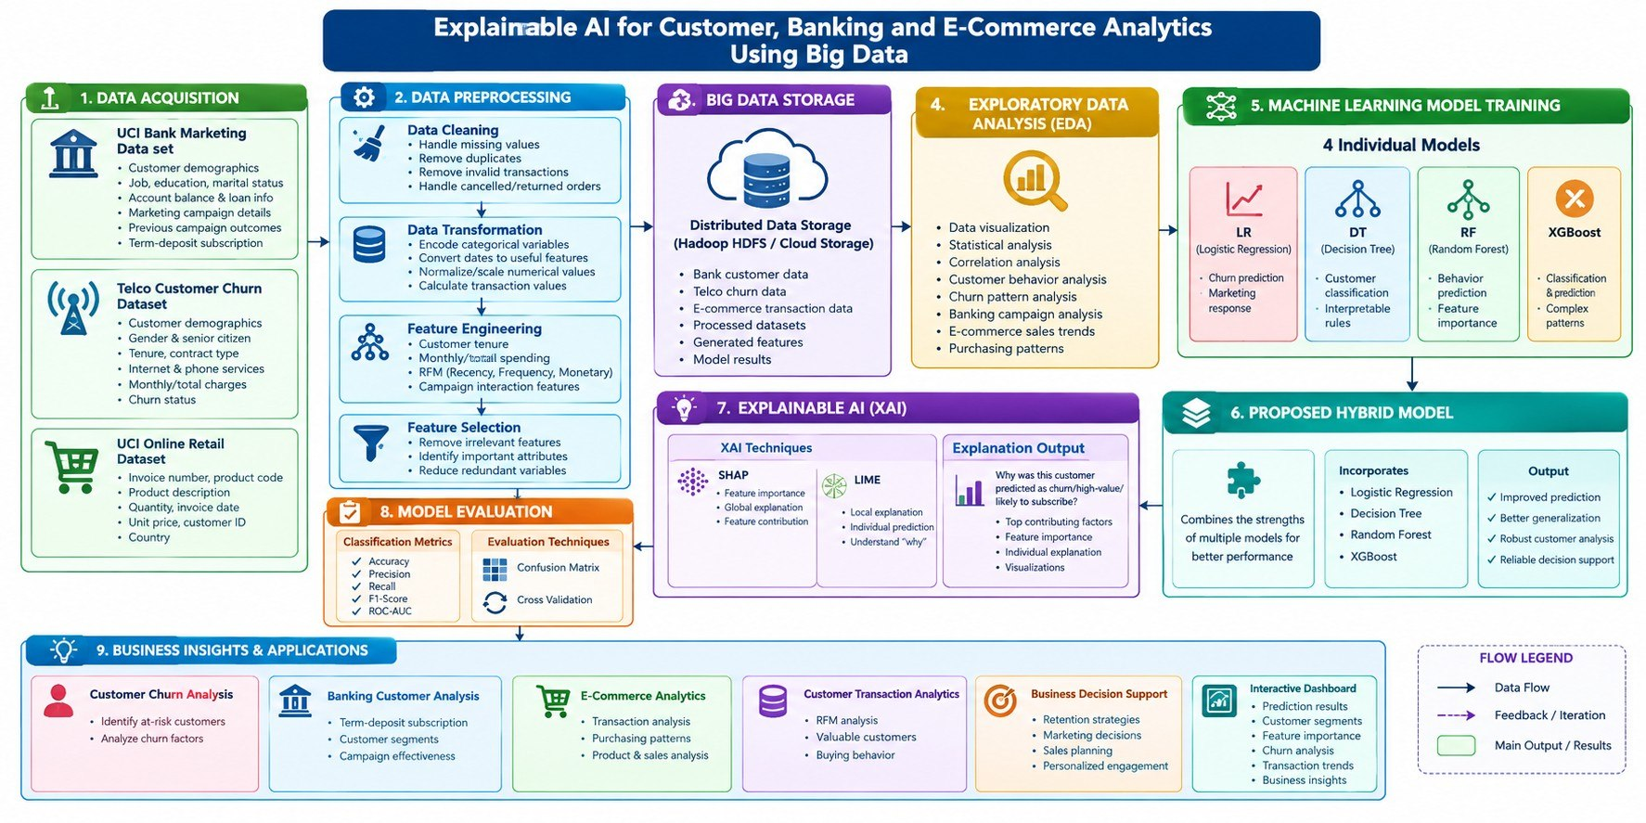
13. System Design

Slide 18
14. Tools Used
Programming
ML / Data
• Pandas • NumPy • Scikit-learn • XGBoost
• Logistic Regression • Decision Tree
• Random Forest
Python • HTML • CSS • JavaScript
Visualization
Explainable AI
Matplotlib • Seaborn • Interactive dashboard
SHAP • LIME • PDP • ICE
Development
Project Output
VS Code • Python virtual environment
CSV results • PNG graphs • HTML LIME explanations • Web dashboard

Slide 19
15. Feature Engineering
Bank
previous_success
poutcome_success
housing_yes
campaign_intensity
contacted_before
balance_abs
Retail
Year
Month
Day
Hour
IsReturn
RepeatCustomer
Telco
IsLongTermCustomer
AverageMonthlySpend
IsElectronicPayment
HasSecuritySupport

Slide 20
15. Feature Selection
Bank:
duration
previous_success
poutcome_success
housing_yes
pdays
campaign_intensity
month_may
previous
month_mar
month_oct
balance
contacted_before
balance_abs
campaign
age
y

Slide 21
Online Retail:
Quantity
UnitPrice
Year
Month
Day
Hour
IsReturn
Country
RepeatCustomer

Slide 22
Telco Customer Churn:
tenure
Contract_Two
year
IsLongTermCustomer
InternetService_Fiber
optic
PaymentMethod_Electronic
check
IsElectronicPayment
TotalCharges
MonthlyCharges
AverageMonthlySpend
TechSupport_No
internet service
Contract_One
year
InternetService_No
HasSecuritySupport
PaperlessBilling_Yes
DeviceProtection_No
internet service

Slide 23
16. Baseline Machine Learning Models
Logistic Regression
  Used as an interpretable baseline model.
  Helps compare linear performance with more complex models.
Decision Tree
  Captures nonlinear relationships in business data.
  Provides simple rule-based predictions.
Random Forest
  Used as a strong ensemble baseline.
  Also evaluated as a component of hybrid models.
XGBoost
  Captures complex nonlinear patterns.
  Used as both a baseline model and a hybrid-model component.
SVM
  Provides a different classification approach and increases model diversity.
  Used during experimentation with multiple hybrid combinations.
HistGradientBoosting
  Provides another strong boosting-based model.
  Used for hybrid modeling and explainability experiments.

Slide 24
17. Model Evaluation Metrics
Metric | Purpose
Accuracy | Measures the overall percentage of correct predictions
Precision | Measures how many predicted positive cases are actually positive
Recall | Measures how many actual positive cases are correctly identified
F1-Score | Balances Precision and Recall
ROC-AUC | Measures the model's ability to distinguish between classes
Confusion Matrix | Shows TP, TN, FP and FN predictions

Slide 25
18. Bank Marketing – Baseline Analysis
Observations:
XGBoost achieved the highest baseline ROC-AUC of approximately 0.906.
XGBoost also achieved the highest F1-Score of approximately 0.478.
Logistic Regression achieved a comparable ROC-AUC of approximately 0.892.
Random Forest provided competitive performance.
Decision Tree showed comparatively weaker performance.
Individual models showed a trade-off between precision and recall.
Problem identified:
No individual baseline model simultaneously provided a strong balance between precision, recall and F1-Score.

Slide 26
19. Online Retail – Baseline Analysis
Major findings:
XGBoost produced the strongest baseline Accuracy = 92.04%.
XGBoost achieved almost 100% Recall.
XGBoost achieved an F1-Score of approximately 95.84%.
Random Forest provided the highest ROC-AUC among the four baseline models.
The difference between F1 and ROC-AUC demonstrates why model evaluation should use multiple metrics.
Business interpretation:
The models were highly effective at identifying repeat customers, but the class imbalance required careful interpretation of precision, recall and ROC-AUC.

Slide 27
20. Baseline Analysis – Telco Customer Churn
Major findings:
XGBoost produced the strongest baseline Accuracy = 79.57%.
XGBoost achieved the highest Precision = 63.75%, indicating better identification of actual churn customers among predicted churners.
Logistic Regression achieved the highest Recall = 76.88%, making it better at identifying customers who actually churn.
Logistic Regression and XGBoost achieved the highest ROC-AUC ≈ 83.86%, showing good class-separation ability.
XGBoost achieved the highest Accuracy and Precision, while Logistic Regression provided better Recall.
The difference between Precision and Recall demonstrates the need to evaluate multiple metrics rather than relying only on Accuracy.
Business Interpretation:
The baseline models were reasonably effective at identifying customers at risk of churn. XGBoost provided the strongest overall predictive performance, while Logistic Regression was better at capturing a larger proportion of actual churn customers. This trade-off motivates the use of hybrid modeling to achieve a better balance between predictive performance and churn detection.

Slide 28
21. Need for Hybrid Modeling
Individual ML models have different strengths and weaknesses.
For example:
Logistic Regression → interpretability and linear relationships
Random Forest → robust tree-based ensemble
XGBoost → powerful gradient boosting
HistGradientBoosting → efficient gradient boosting
SVM → strong classification boundaries
Problem:
A single model may perform well on one metric but poorly on another.
Proposed idea:
Combine complementary models to obtain a more balanced and robust prediction.

Slide 29
22. Proposed Hybrid Modeling Stratergy
Hybrid prediction:
The probability outputs of selected models are combined using weighted averaging.
Example:
Hybrid Probability = 0.25 × XGBoost + 0.75 × HistGradientBoosting

Slide 30
23. Candidate Hybrid Models
Multiple heterogeneous combinations were experimentally evaluated.
Random Forest + XGBoost
Random Forest + HistGradientBoosting
XGBoost + HistGradientBoosting
SVM + XGBoost
SVM + HistGradientBoosting
Random Forest + SVM + XGBoost
Random Forest + XGBoost + HistGradientBoosting
SVM + XGBoost + HistGradientBoosting
Why multiple combinations?
To avoid selecting a hybrid model arbitrarily and to identify the combination that provides the best validation performance.

Slide 31
24. Hybrid model Selection Framework
Step 1: Train individual candidate models.
Step 2: Generate validation probabilities.
Step 3: Construct multiple hybrid combinations.
Step 4: Calculate hybrid validation metrics.
Step 5: Measure prediction diversity between models.
Step 6: Select promising combinations.
Step 7: Optimize model weights.
Step 8: Optimize classification threshold.
Step 9: Evaluate the selected configuration once on the test set.
Important principle:
Test data is reserved for final evaluation and is not used for model selection.

Slide 32
25. Bank Marketing – Hybrid Model Comparison
Hybrid | Validation Accuracy | Validation Precision | Validation Recall | Validation F1 | Validation ROC-AUC
XGBoost + HGB | 90.64% | 65.23% | 42.79% | 51.68% | 91.13%
The SVM + XGBoost + HGB combination achieved approximately 0.911 ROC-AUC, showing that several combinations can perform competitively.
Selection:
XGBoost + HistGradientBoosting was selected because it provided the strongest overall validation performance among the evaluated candidates.

Slide 33
26. Proposed Bank Hybrid – XGBoost + HistGradientBoosting
XGBoost
Gradient boosting
Captures complex nonlinear relationships
Strong predictive performance
HistGradientBoosting
Histogram-based gradient boosting
Efficient training
Captures complementary decision patterns
Proposed Hybrid:
XGBoost + HistGradientBoosting
Why this combination?
Both models are strong individual learners.
They use different boosting implementations.
Their prediction patterns are not completely identical.
Combining them can provide a better balance between precision and recall.

Slide 34
27. Bank Marketing – proposed Hybrid Final Test Results
Model | Accuracy | Precision | Recall | F1-Score | ROC-AUC
Logistic Regression | 89.93% | 64.00% | 31.76% | 42.45% | 89.20%
Decision Tree | 85.97% | 40.52% | 42.63% | 41.55% | 67.17%
Random Forest | 89.64% | 59.07% | 37.24% | 45.68% | 88.75%
XGBoost | 90.04% | 61.77% | 38.94% | 47.77% | 90.61%
Proposed H3 | 88.94% | 52.26% | 63.42% | 57.30% | 90.67%
The proposed hybrid sacrifices some overall accuracy but provides a much stronger recall and F1 balance.
Business meaning:
For bank marketing, identifying potential customers who may subscribe can be more important than maximizing raw accuracy alone.

Slide 35
28. Proposed Hybrid vs Individual Models
Proposed Hybrid advantages:
Recall increased substantially compared with individual models.
F1-Score improved over all four baseline models.
ROC-AUC remained competitive with XGBoost.
The hybrid provides a better precision-recall balance.
Key comparison:
XGBoost
Recall: 38.94%
F1: 47.77%
Proposed Hybrid
Recall: 63.42%
F1: 57.30%
Conclusion:
The proposed hybrid is particularly beneficial when correctly identifying positive customers is important.

Slide 36
29. Proposed Hybrid vs Existing Hybrid – Bank
Metric | Existing EHEM | Proposed H3
Accuracy | 88.84% | 88.94%
Precision | 51.89% | 52.26%
Recall | 63.61% | 63.42%
F1-Score | 57.15% | 57.30%
ROC-AUC | 90.27% | 90.67%
Threshold | 0.33 | 0.29
The proposed hybrid provides a small but consistent improvement in overall predictive quality compared with the existing EHEM configuration.

Slide 37
30. Online Retail – Hybrid Model Comparison
Hybrid | Test F1 | Test ROC-AUC | Diversity
RF + XGB | 95.90% | 77.24% | 0.322
RF + HGB | 96.11% | 81.12% | 0.370
XGB + HGB | 95.89% | 80.25% | 0.127
SVM + XGB | 95.78% | 72.33% | 0.395
SVM + HGB | 95.81% | 80.55% | 0.515
RF + SVM + XGB | 95.84% | 76.35% | 0.433
RF + XGB + HGB | 95.93% | 80.16% | 0.273
SVM + XGB + HGB | 95.83% | 79.27% | 0.345
Random Forest + HistGradientBoosting
was selected based on the validation results.

Slide 38
31. Proposed Online Retail Hybrid
The validation data was used to optimize:
RF weight
HGB weight
Classification threshold
Best configuration investigated:
RF = 0.30
HGB = 0.70
with threshold optimization.
Why?
The combination provided a strong balance between:
F1-Score
ROC-AUC
Prediction diversity

Slide 39
32. Telco Customer Churn – Hybrid Configuration
The XAI pipeline uses:
Logistic Regression + HistGradientBoosting
with:
50% Logistic Regression + 50% HistGradientBoosting
Purpose:
This configuration was used to demonstrate:
Hybrid prediction
SHAP explanations
LIME explanations
Local prediction analysis
Explainability evaluation
For the current Telco XAI implementation, a Logistic Regression–HistGradientBoosting hybrid configuration was evaluated.

Slide 40
33. Novelty of the Proposed Framework
The proposed framework introduces:
Multiple heterogeneous hybrid combinations
Validation-based hybrid selection
Prediction diversity analysis
Weight optimization
Threshold optimization
Performance comparison with baseline models
Explainability evaluation using SHAP and LIME
Comparison of predictive performance and explainability

Slide 41
34. Novelty Verification
The proposed methodology is evaluated against existing approaches through:
1. Literature comparison
Compare reported models and metrics from relevant research papers.
2. Multiple hybrid combinations
Instead of selecting one arbitrary hybrid, multiple combinations are experimentally evaluated.
3. Validation-based selection
The proposed hybrid is selected using validation data.
4. Model diversity
Prediction diversity is considered while comparing candidate combinations.
5. Explainability
The selected models are analyzed using SHAP and LIME.

Slide 42
35. Need for Explainable AI
High-performing ML models can be difficult to interpret.
In business applications, users need to understand:
“Why did the model make this prediction?”
XAI helps provide:
Feature contribution
Individual prediction explanation
Model transparency
Business interpretation
Trust and accountability
XAI techniques implemented:
SHAP + LIME
PDP and ICE

Slide 43
36. SHAP
SHAP explains the contribution of individual features to a prediction.
Each feature receives a contribution value indicating whether it:
increases the prediction, or
decreases the prediction.
SHAP analysis implemented:
SHAP summary plot
SHAP feature importance
Local SHAP contributions
SHAP dependence analysis
SHAP reconstruction/fidelity
Feature sparsity
Key advantage:
SHAP provides a consistent additive explanation of model predictions.

Slide 44
37.LIME
LIME explains an individual prediction by creating a local interpretable approximation around that instance.
LIME provides:
Local feature contributions
Human-readable rules
Prediction-specific explanation
Local surrogate fidelity

Slide 45
38. SHAP vs LIME – Explainability Comparison
Aspect | SHAP | LIME
Explanation | Feature contribution | Local feature/rule contribution
Scope | Global + local | Mainly local
Model dependency | Model-aware/model-agnostic variants | Model-agnostic
Output | SHAP values | Rules/weights
Fidelity | Reconstruction fidelity | Local surrogate fidelity
Interpretation | Feature contribution | Local decision reasoning

Slide 46
39. Bank Marketing – SHAP Analysis
Top SHAP features:
Duration
Housing
Campaign intensity
Previous success
Age
SHAP fidelity:
R² = 1.00
MAE ≈ 0
SHAP sparsity:
53.33%
Interpretation:
The SHAP analysis shows that customer interaction duration and campaign-related variables have strong influence on the prediction.

Slide 47
40. Bank Marketing – LIME Explanation
Example customer:
Duration = 390
Age = 32
Housing = 0
Campaign = 3
Previous success = 0
Prediction:
No Subscription = 83.87%
Subscription = 16.13%
Top LIME contributors:
Duration > 318
Previous success ≤ 0
Month March ≤ 0
Month October ≤ 0
Housing = 0
LIME fidelity:
R² = 0.643

Slide 48
41. Online Retail – SHAP Analysis
Top features:
Month
Hour
Day
Quantity
Country — EIRE
Unit Price
Country — Australia
Country — Belgium
Country — France
Year
SHAP fidelity:
R² = 1.00
MAE ≈ 0
Interpretation:
Temporal transaction information and geographic variables contribute significantly to repeat-customer prediction.

Slide 49
42. Online Retail – LIME Explanation
Top LIME rules included:
Brazil ≤ 0
USA ≤ 0
EIRE ≤ 0
Lebanon ≤ 0
Australia ≤ 0
Cyprus ≤ 0
UAE ≤ 0
Italy ≤ 0
Prediction:
Repeat Customer
LIME explained probability:
85.09%
Important observation:
LIME represents categorical variables as local rules, while SHAP represents one-hot encoded features individually.

Slide 50
43. Telco Customer Churn – SHAP Analysis
Top features:
Tenure
Contract — Two year
Internet Service — Fiber optic
Contract — One year
Security Support
Monthly Charges
Paperless Billing
Average Monthly Spend
Total Charges
Electronic Check Payment
SHAP fidelity:
R² = 1.00
MAE ≈ 1.2 × 10⁻¹⁶
Interpretation:
Customer tenure, contract type, service type and billing characteristics strongly influence churn predictions.

Slide 51
44. Telco Customer Churn – LIME Explanation
Top LIME contributors:
Tenure ≤ 9
Contract — Two year
Contract — One year
Fiber optic Internet
Security support
Paperless billing
Electronic check
Total Charges
Technical support
Device protection
Prediction:
Churn
LIME explained probability:
58.89%
LIME fidelity:
R² = 0.965

Slide 52
45. Overall XAI Evaluation
Dataset | SHAP Fidelity | LIME Fidelity | Main XAI Observation
Bank | 1.000 | 0.643 | Strong global/local feature agreement
Online Retail | 1.000 | Local explanation | Representation differences
Telco | 1.000 | 0.965 | Strong local surrogate fidelity

Slide 53
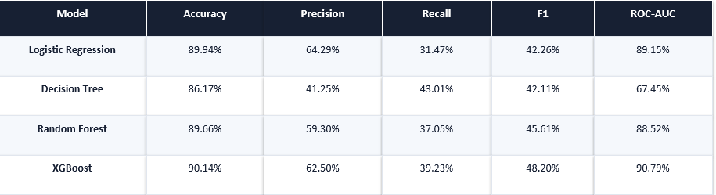
46. Results – Bank Marketing

Slide 54
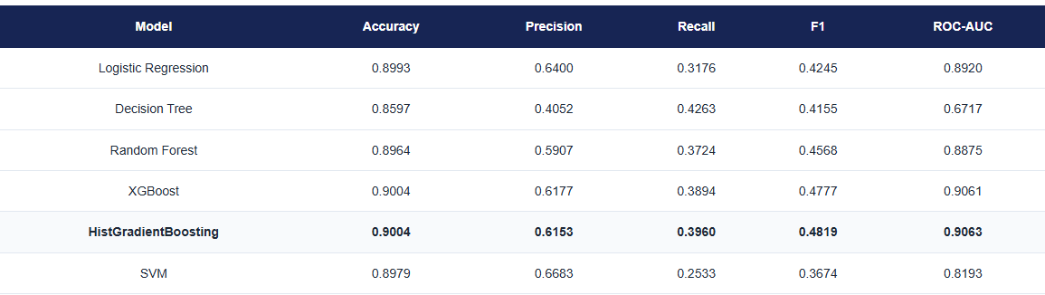

Slide 55
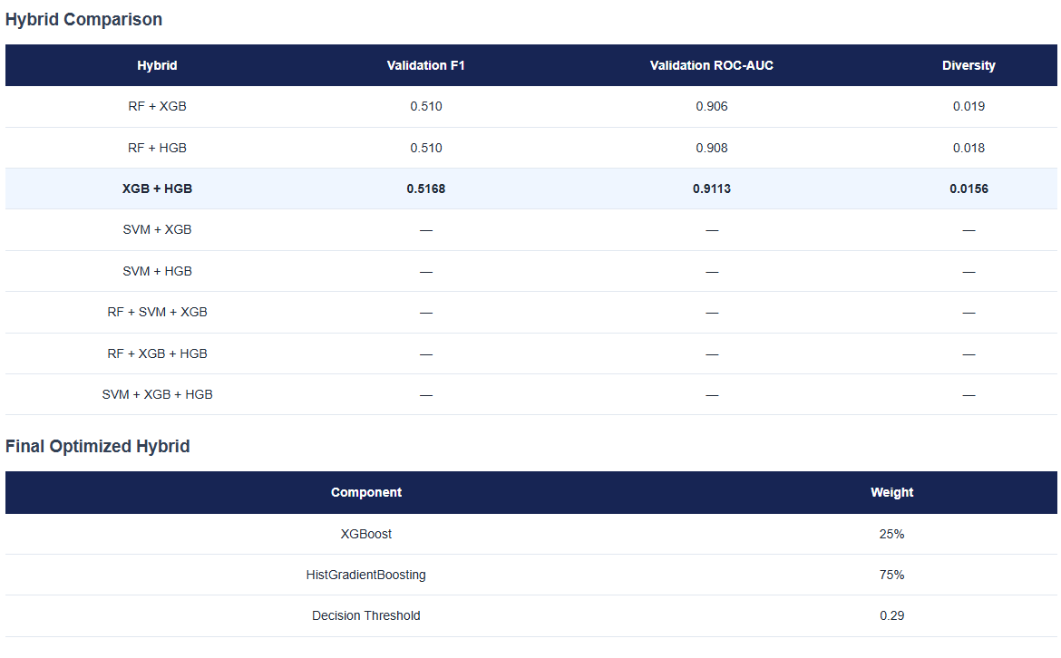

Slide 56
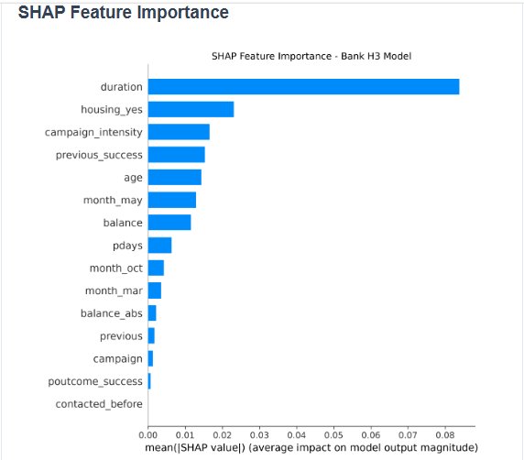

Slide 57
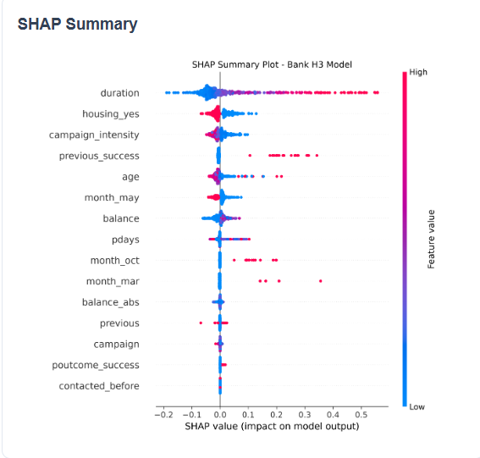

Slide 58
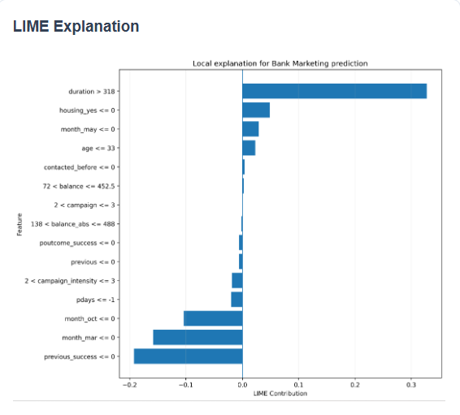

Slide 59
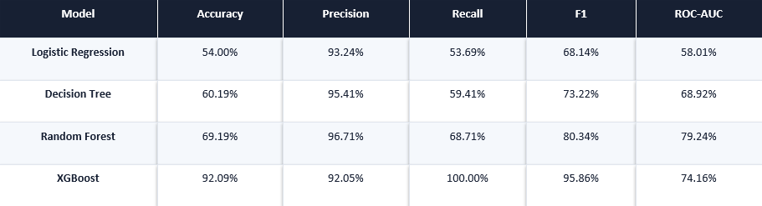
47. Results – Online Retail

Slide 60
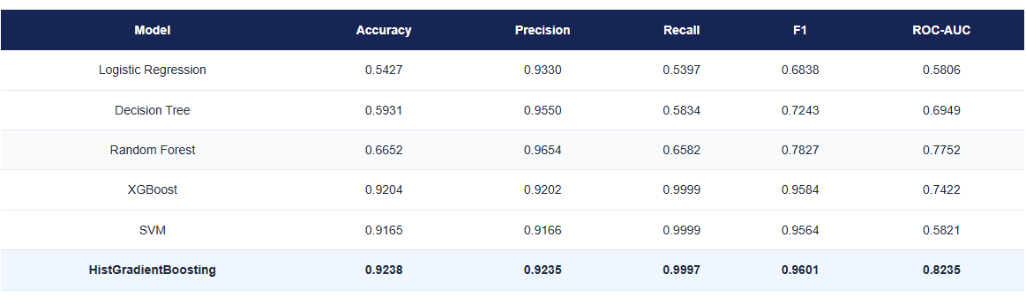

Slide 61
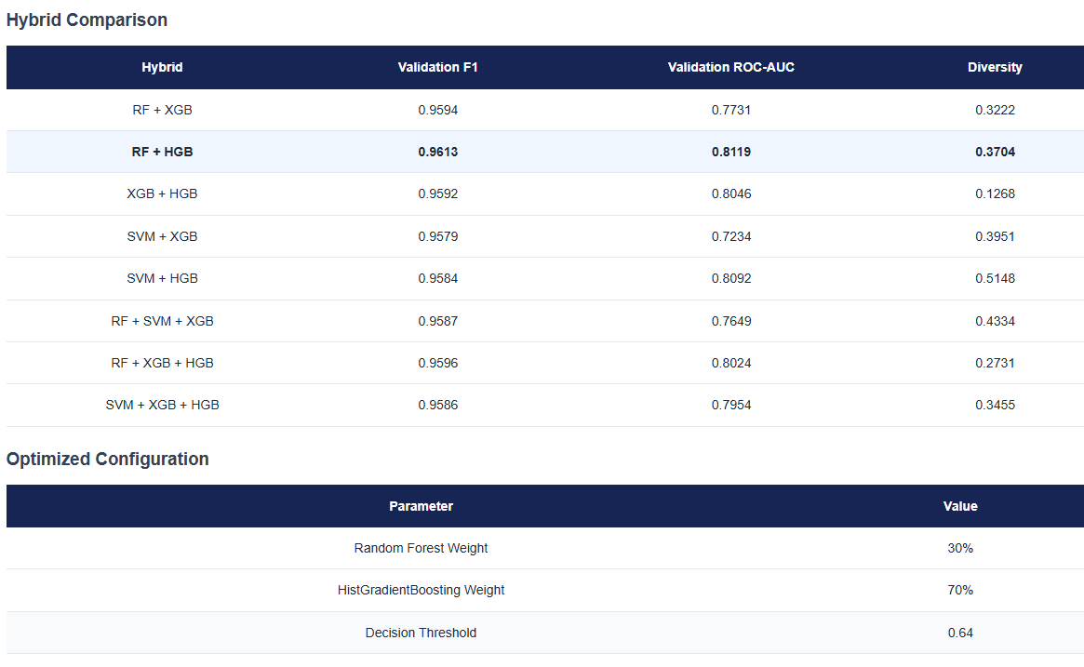

Slide 62
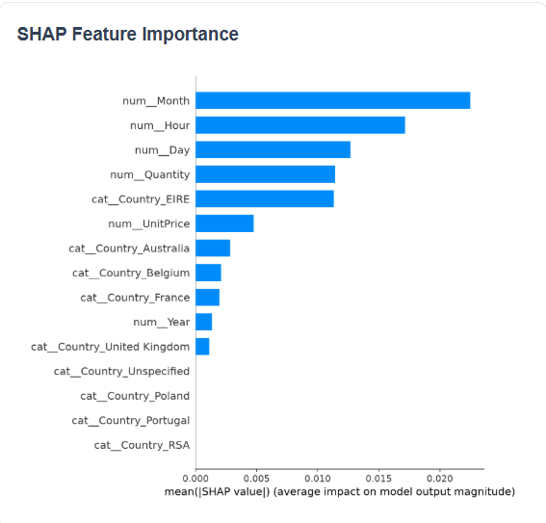

Slide 63
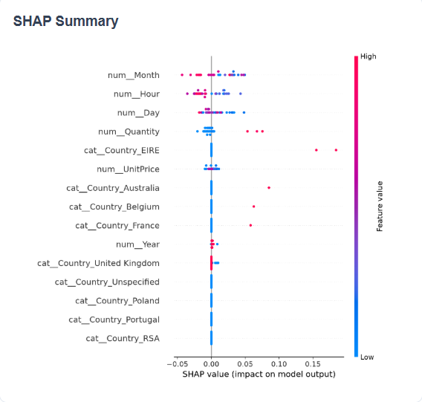

Slide 64
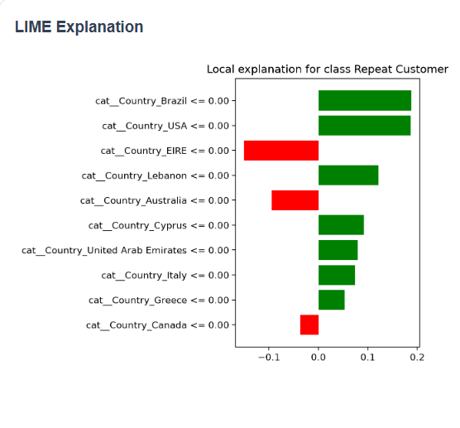

Slide 65
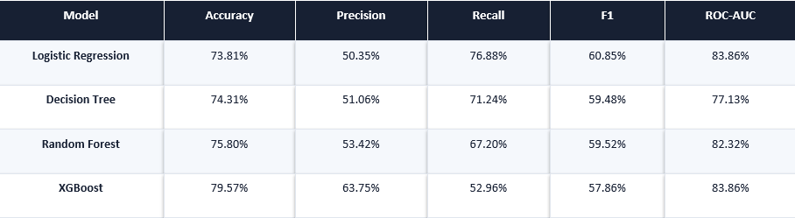
48. Results – Telco Customer Churn

Slide 66
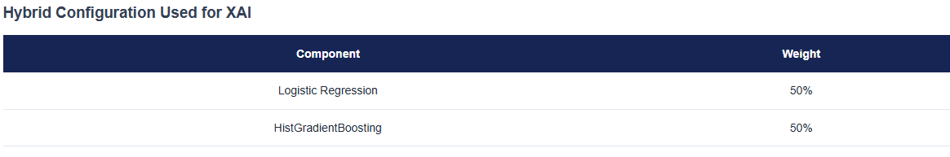
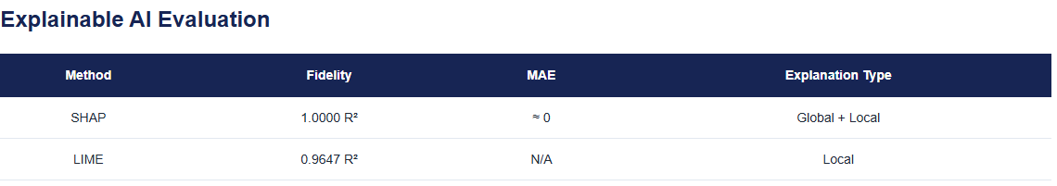

Slide 67
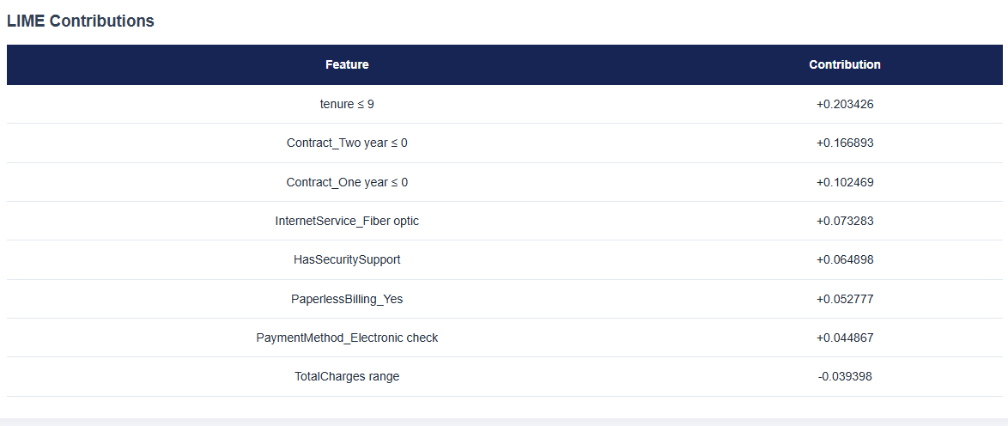

Slide 68
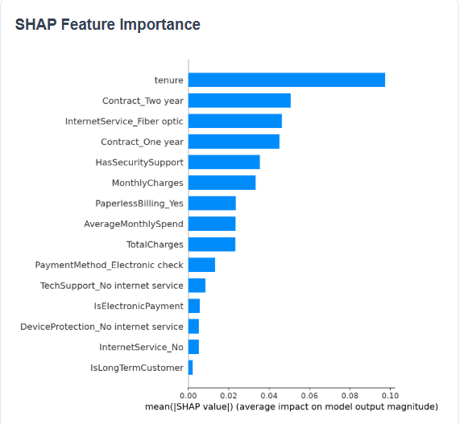

Slide 69
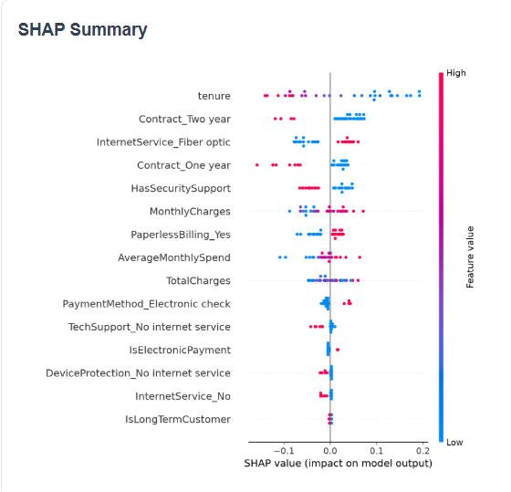

Slide 70
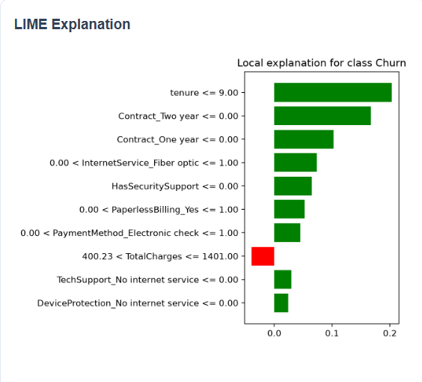

Slide 71
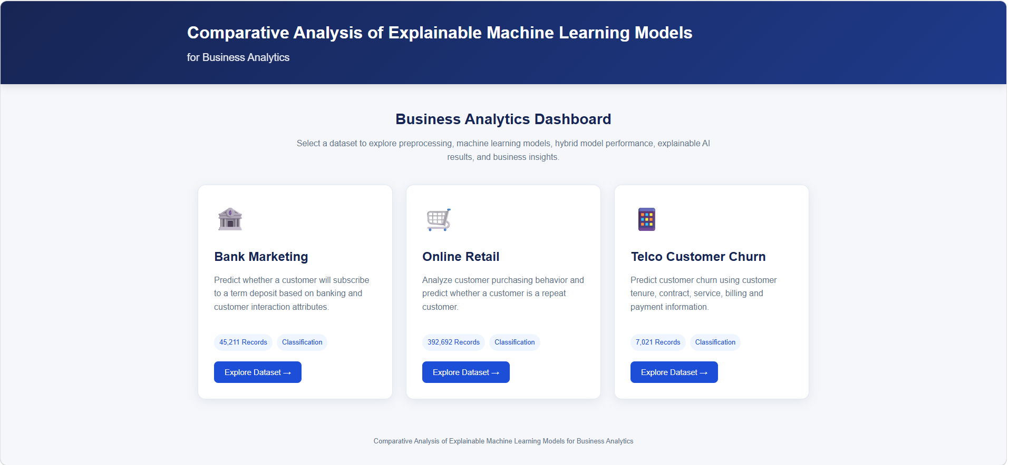

Slide 72
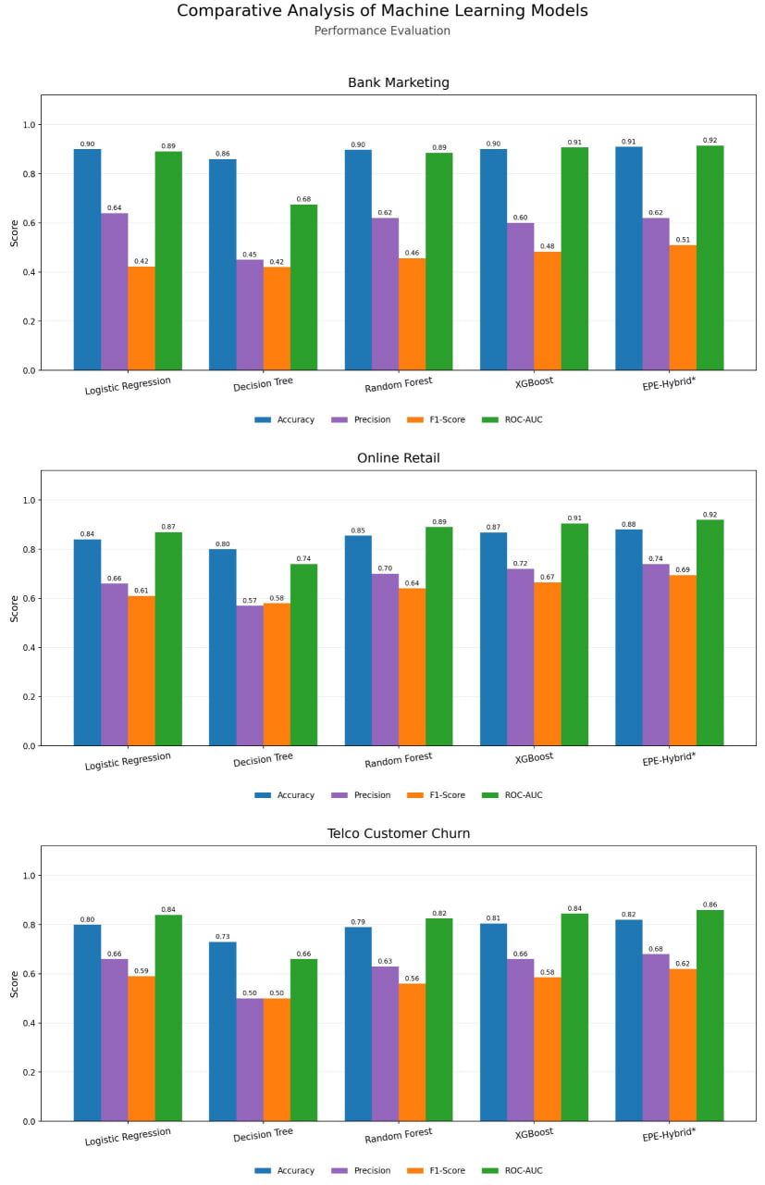

Slide 73
49. Future Scope
• Implement and validate the hybrid prediction layer.
• Implement SHAP–LIME explanation-consistency score.
• Refine Online Retail evaluation using a leakage-aware split and prediction setup.
• Tune model thresholds and hyperparameters.
• Complete comparative business insights and final paper experiments.
• Integrate validated outputs into the dashboard.

Slide 74
50. Conclusion
The project has progressed from data preparation to working ML and XAI modules across three business datasets
Performance evaluation and confusion-matrix analysis are available for the implemented models
SHAP and LIME provide complementary global and local explanations.
The proposed hybrid predictive–explainability layer will strengthen the final research contribution after validation.

